Slide 1
IBM Data Science Final

Slide 2
Business Problem
John is interested in opening a food truck in the Toronto area.
QUESTION: Where does John bring the food truck?
He has provided research showing that these places are optimal for food truck sales.
Universities
colleges
parks
public libraries
event spaces

Slide 3
Data
The Foursquare API will be used to search for the venues listed
Report will focus on the downtown core
Data will look for
name
category
latitude
longitude
state

Slide 4
Methodology
Gather data in the 5 categories outlined above
Universitie’s, colleges, park, public libraries, event spaces.
Clean the data so that it only contains
Address, type of venue, name, latitude, longitude
Put all of the information into one data frame
Visualize to gain insight on the data
Run KNN algorithm to see where the clusters are

Slide 5
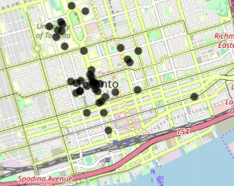
Results
There are clearly three major clusters.. Which will later be confirmed by the KNN algorithm

Slide 6
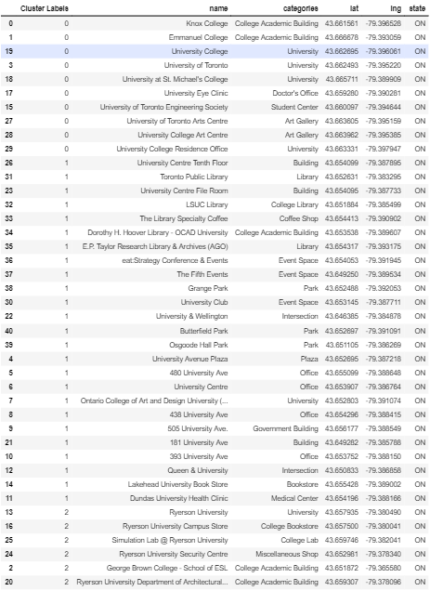
Results list and cluster group

Slide 7
Discussion/Conclusion
Thank you for taking the time to grade this report. The goal of this was to use data science in order to answer a question about where a food truck should be located to maximize profitability. Ultimately, using a KNN regression algorithm allowed for this to happen and the business owner will benefit from this in the future.

